Slide 1


DEV Bulletin
By: Mike Johnson, William Bain, Ben Anderson, Jason Nestor

Slide 2
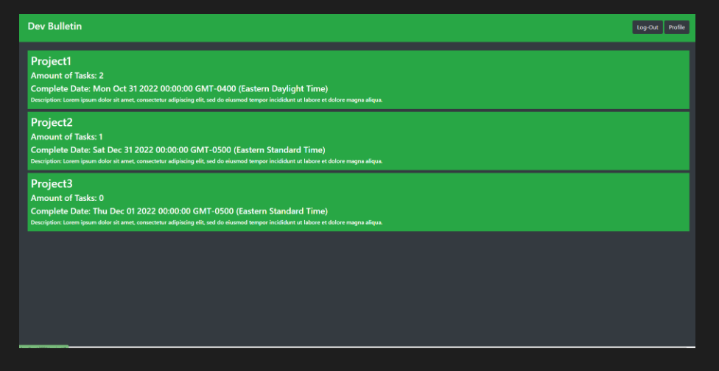


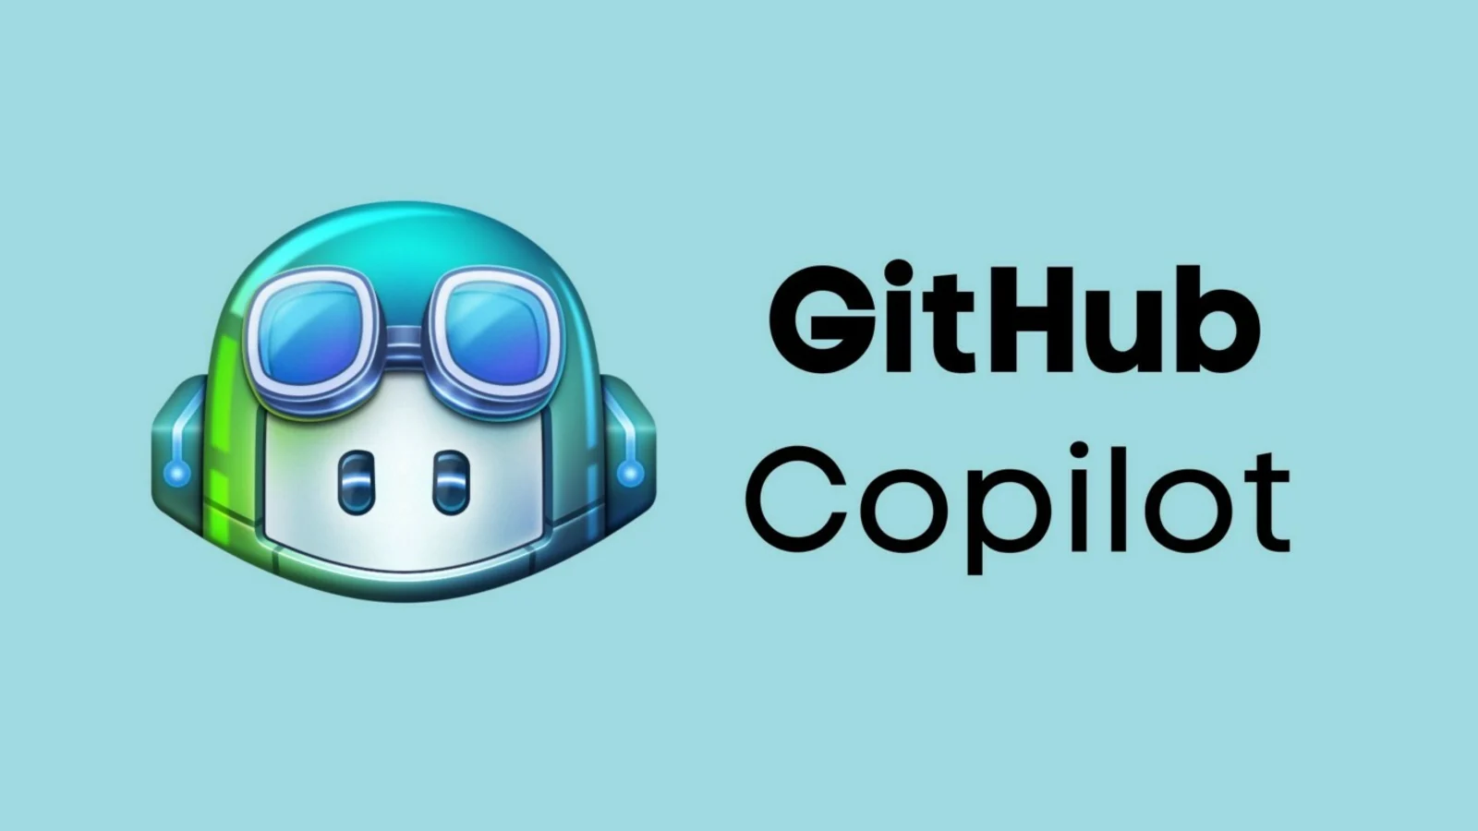
Dev Bulletin Why?
Since the coming out of GitHub’s AI model of Copilot. People are worried about the security of this program taking functions from open-source projects in this AI program. GitHub had openly admitted that if you publish an open-source project you are contributing
What Does This Mean as a Team?
Project Managers – This can cause your way of creating a project or personal management preferences to become compromised.
Developers – This is a dangerous game messing with AI. People have seen their functions that the have written in the GitHub AI when they are using this program.

Slide 3
Our Solution
Our solution is to create the next GitHub.
Companies don’t understand this, but we don’t want you to use our data for advertisement revenue and we want our privacy back.
What will we do differently?
We will NEVER EVER use your projects as data for our projects.
No ad tracking EVER
You can put a fake email(no verification)
Cookies are only used for you never sold to a 3rd party or used by us.

Slide 4
What We Have Implement So Far?
Node Modules – Thousands of programs = Hundreds of ways to stay secure
Bcryipt – Devs will never know your password.
Squelize and Express Session – Provides a better user experience.
Express File Upload – Ability to host and share files here for your projects.
MySQL2 – Store user data.
Nodemon – Used for development a constant refreshing sever every time a file is changed keeps labor costs down.
Handlebars – Backend Templating Engine

Slide 5
Demo
https://whispering-journey-87250.herokuapp.com/

Slide 6
Future Development
Running on a paid server or a Network Attached Storage.
Design and Model Specifics – Develop more in-depth models so that certain users have access to a project that they are only assigned a task.
Possible Freelancers – Setting certain tasks to individuals and having a payment platform or API like Stripe to avoid data collection on our part.
Personal Projects – The goal is to do the same thing as GitHub, but your privacy and project specifics are never tracked.
File Encryption – Providing peace of mind to the users that unless someone has a password, they won’t be able to see the file.
Bot Detection and/or Captchas – This is something that we will use to uphold to no email verification policy.

Slide 7
What Can You Do Until This Is Released?
Run a VPN (Virtual Private) – Express VPN and Nord VPN are just 2 of the massive market of VPNs.
Use GitLab instead of GitHub.
Look for companies that put people over profit!!!

Slide 8
Thank You
By: By: Mike Johnson, William Bain, Ben Anderson, Jason Nestor

